Slide 1
Lecture 14: Neural Networks

Slide 2
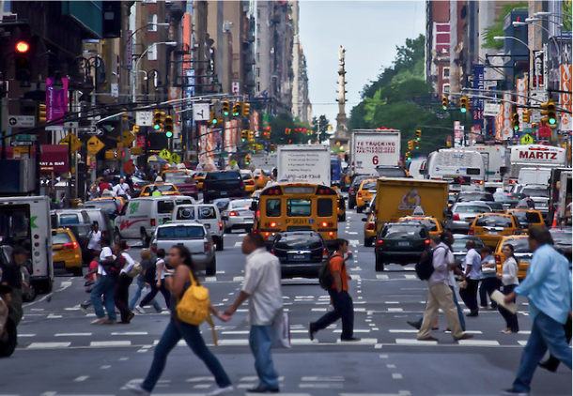
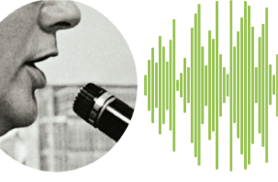
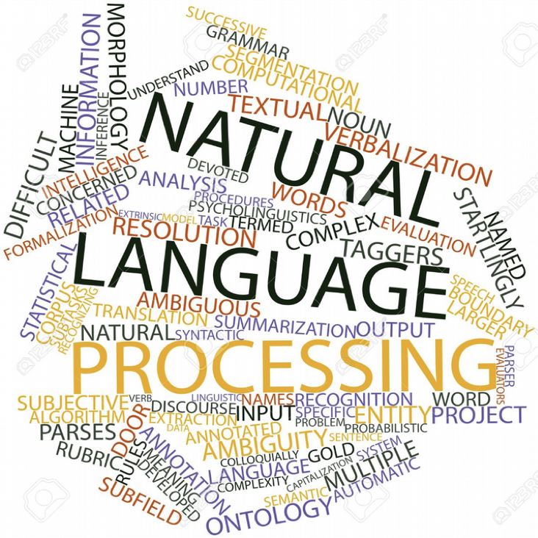

Slide 4
"Intelligence is 10 million rules." --Doug Lenat
Notes:
The human brain has about 100 billion neurons.
With an estimated average of one thousand connections between each neuron and its neighbors,
we have about 100 trillion connections, each capable of a simultaneous calculation...
(but) only 200 calculations per second...
With 100 trillion connections, each computing at 200 calculations per second, we get 20 million billion calculations per second.
by the year 2020, a massively parallel neural net computer [will be able to perform] about 20 million billion neural connection calculations per second,
which is equal to the human brain.
Ray Kurzweil, "The Age of Spiritual Machines", 1999

Slide 5
The Brain
Highly complex, non-linear and parallel information processing system
~ 1011 neurons
~ 1015 synapses
Glial cells even more numerous
On certain tasks, brain is much faster than supercomputers of today, even though neurons are very slow
Mostly(?) prewired at birth, but very plastic throughout life importance of learning: involves 3 mechanisms
modification (and death) of existing synapses
generation of new synapses
generation of new neural cells

Slide 6
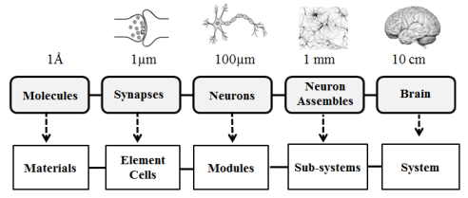

Slide 8
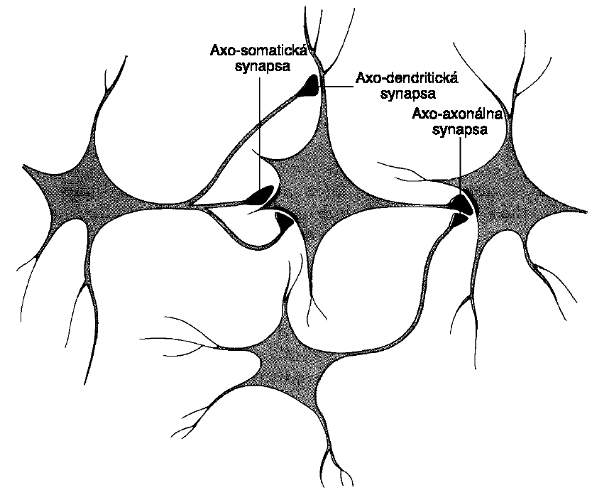
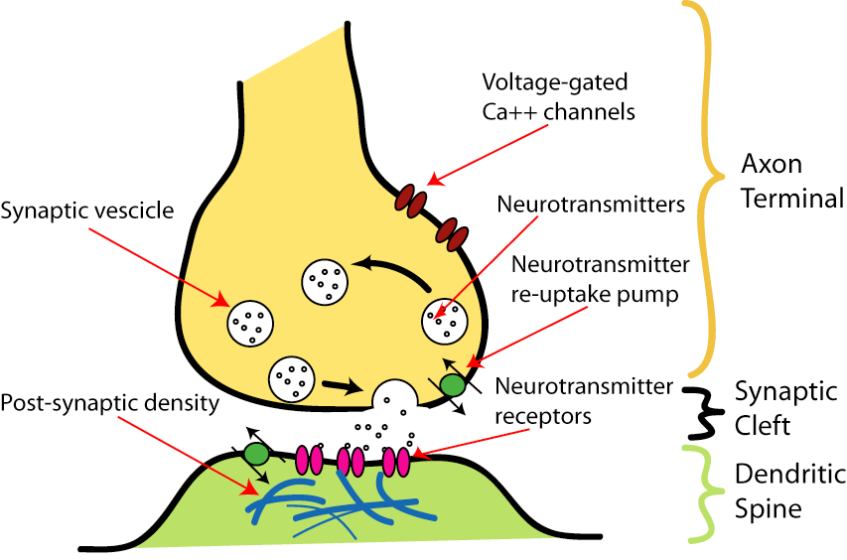

Slide 10
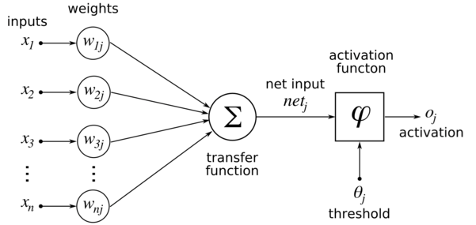
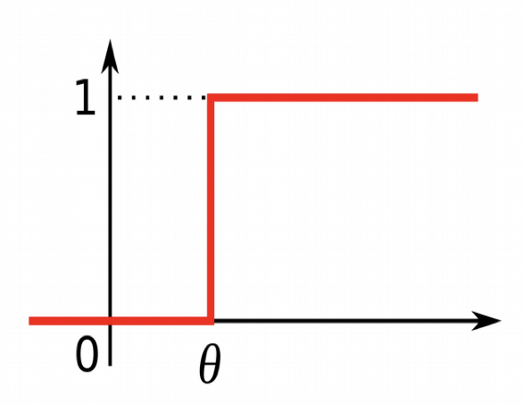
Artificial Neural Networks
linear
decision
boundary

Slide 11
Gradient Descent Learning
Compare prediction to reality to get a measure of “error” or “loss”
Given direction of error, measure whether weights were too high or too low for that x;
For example, in y = b0 + b1*x1
if our b0 = 1 and our b1 = -1
And x = 1 and y = 2
Then our prediction was y = 1 + -1*1 = 0
This value was too low by 2, so our cost/error/loss = 2
We want to change our weights in a way that gets us closer to the right answer

Slide 12
Learning Rate

Slide 13
Normalized Data

Slide 14
Neural networks and logical computations
We can simple, single layer ANNs to implement the basic logic gates (e.g. AND, OR, NOT).
It is well known from logic that we can construct any logical function from these three basic logic gates.
All we need to do is find the appropriate connection weights and neuron thresholds to produce the right outputs for each set of inputs.
We shall see explicitly how one can construct simple networks that perform NOT, AND, and OR.

Slide 15
Computing Logical AND
x₁ | x₂ | y
0 | 0 | 0
0 | 1 | 0
1 | 0 | 0
1 | 1 | 1

Slide 16
Computing Logical AND
x₁ | x₂ | y
0 | 0 | 0
0 | 1 | 0
1 | 0 | 0
1 | 1 | 1
1
x₂
0
0
x₂
1

Slide 17
Computing Logical AND
x₁ | x₂ | y
0 | 0 | 0
0 | 1 | 0
1 | 0 | 0
1 | 1 | 1
1
x₂
0
0
x₂
1

Slide 18
Computing Logical AND
x₁ | x₂ | y
0 | 0 | 0
0 | 1 | 0
1 | 0 | 0
1 | 1 | 1
1
y
0
x₂
b₀
b₂
b₁
0
0
x₁
1
1
0
0
x₀
x₁
x₂
What weights do we need?

Slide 19
Computing Logical AND
x₁ | x₂ | y
0 | 0 | 0
0 | 1 | 0
1 | 0 | 0
1 | 1 | 1
1
y
0
x₂
b₀
b₂
b₁
0
0
x₁
1
1
1
0
x₀
x₁
x₂
What weights do we need?

Slide 20
Computing Logical AND
x₁ | x₂ | y
0 | 0 | 0
0 | 1 | 0
1 | 0 | 0
1 | 1 | 1
1
y
0
x₂
b₀
b₂
b₁
0
0
x₁
1
1
0
1
x₀
x₁
x₂
What weights do we need?

Slide 21
Computing Logical AND
x₁ | x₂ | y
0 | 0 | 0
0 | 1 | 0
1 | 0 | 0
1 | 1 | 1
1
y
1
x₂
b₀
b₂
b₁
0
0
x₁
1
1
1
1
x₀
x₁
x₂
What weights do we need?

Slide 22
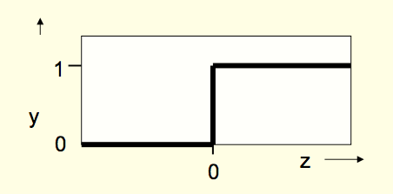
Computing Logical AND
Z = b₀*x₀ + b₁*x₁ * b₂*x₂
x₁ | x₂ | y
0 | 0 | 0
0 | 1 | 0
1 | 0 | 0
1 | 1 | 1
1
y
1
x₂
b₀
b₂
b₁
0
0
x₁
1
1
1
1
x₀
x₁
x₂
What weights do we need?

Slide 23
Computing Logical AND
Z = b₀*x₀ + b₁*x₁ * b₂*x₂
x₁ | x₂ | y
0 | 0 | 0
0 | 1 | 0
1 | 0 | 0
1 | 1 | 1
1
y
1
x₂
b₀
b₂
b₁
0
0
x₁
1
1
1
1
x₀
x₁
x₂
What weights do we need?
b₀ = -1
b₁ = 0.5
b₂ = 0.5

Slide 24
Computing Logical OR
x₁ | x₂ | y
0 | 0 | 0
0 | 1 | 1
1 | 0 | 1
1 | 1 | 1

Slide 25
Computing Logical OR
x₁ | x₂ | y
0 | 0 | 0
0 | 1 | 1
1 | 0 | 1
1 | 1 | 1
1
x₂
0
0
x₁
1

Slide 26
Computing Logical OR
Z = b₀*x₀ + b₁*x₁ * b₂*x₂
x₁ | x₂ | y
0 | 0 | 0
0 | 1 | 1
1 | 0 | 1
1 | 1 | 1
1
y
1
x₂
b₀
b₂
b₁
0
0
x₁
1
1
0
1
x₀
x₁
x₂
What weights do we need?

Slide 27
Computing Logical OR
Z = b₀*x₀ + b₁*x₁ * b₂*x₂
x₁ | x₂ | y
0 | 0 | 0
0 | 1 | 1
1 | 0 | 1
1 | 1 | 1
1
y
1
x₂
b₀
b₂
b₁
0
0
x₁
1
1
0
1
x₀
x₁
x₂
What weights do we need?
b₀ = -0.5
b₁ = 0.5
b₂ = 0.5

Slide 28
Computing Logical NOT OR
x₁ | x₂ | y
0 | 0 | 1
0 | 1 | 0
1 | 0 | 0
1 | 1 | 0

Slide 29
Computing Logical NOT OR
x₁ | x₂ | y
0 | 0 | 1
0 | 1 | 0
1 | 0 | 0
1 | 1 | 0
1
x₂
0
0
x₁
1

Slide 30
Computing Logical NOT OR
Z = b₀*x₀ + b₁*x₁ * b₂*x₂
x₁ | x₂ | y
0 | 0 | 1
0 | 1 | 0
1 | 0 | 0
1 | 1 | 0
1
y
1
x₂
b₀
b₂
b₁
0
0
x₁
1
1
0
1
x₀
x₁
x₂
What weights do we need?

Slide 31
Computing Logical NOT OR
Z = b₀*x₀ + b₁*x₁ * b₂*x₂
x₁ | x₂ | y
0 | 0 | 1
0 | 1 | 0
1 | 0 | 0
1 | 1 | 0
1
y
1
x₂
b₀
b₂
b₁
0
0
x₁
1
1
0
1
x₀
x₁
x₂
What weights do we need?
b₀ = 0.5
b₁ = -0.51
b₂ = -0.51

Slide 32
Computing Logical XOR
Z = b₀*x₀ + b₁*x₁ * b₂*x₂
x₁ | x₂ | y
0 | 0 | 0
0 | 1 | 1
1 | 0 | 1
1 | 1 | 0
1
y
1
x₂
b₀
b₂
b₁
0
0
x₁
1
1
0
1
x₀
x₁
x₂
What weights do we need?
b₀ = 1.0
b₁ = -0.51
b₂ = -0.51

Slide 33
Computing Logical XOR
x₁ | x₂ | y
0 | 0 | 0
0 | 1 | 1
1 | 0 | 1
1 | 1 | 0

Slide 34
Computing Logical XOR
Z = b₀*x₀ + b₁*x₁ * b₂*x₂
x₁ | x₂ | y
0 | 0 | 0
0 | 1 | 1
1 | 0 | 1
1 | 1 | 0
1
y
1
x₂
b₀
b₂
b₁
0
0
x₁
1
1
0
1
x₀
x₁
x₂
What weights do we need?

Slide 35
The X-OR Problem
Or more generally, the problem of lack of linear separability

Slide 36
Real World Examples of x-or problems
Multiplying by -1
One lane to cross a bridge
Is it good to use an umbrella, depending on whether you are inside or outside
There are several x-or examples in our animals dataset

Slide 37


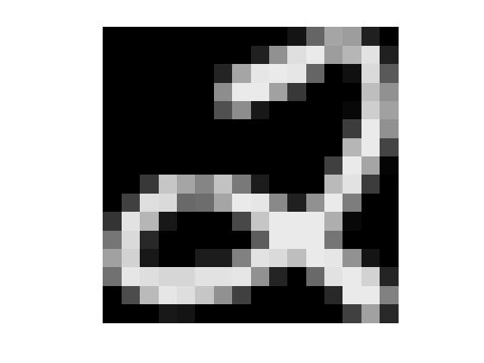
X₁
w₁
X₂
w₂
X₃
w₃
Σ
w₄
X₄
w_{n}
X_{n}
0 0 1 1 0 1 0 1 0 1 0 1 1
.95 .85 .79 .23 .04 .01 ..

Slide 38
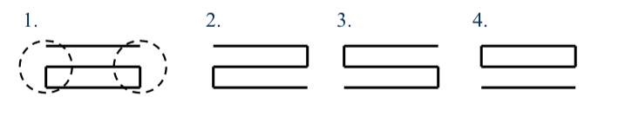

Slide 39
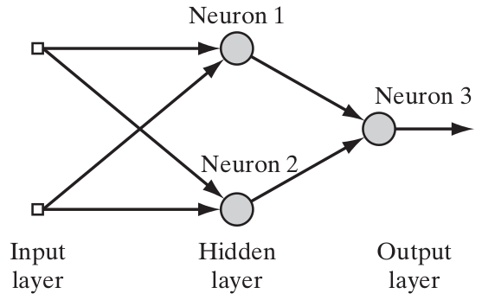
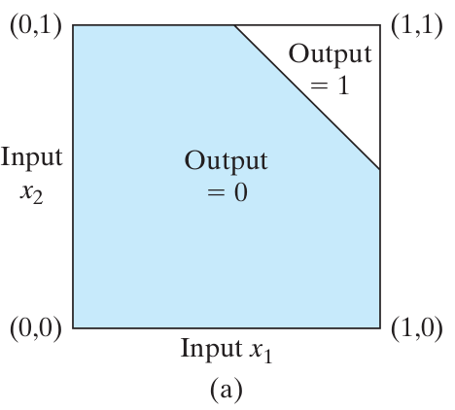
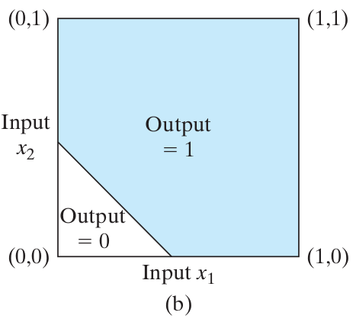
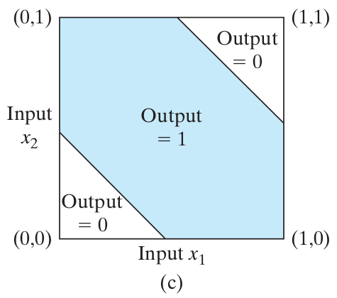
Multilayer networks and Deep Neural Networks

Slide 40
Hidden Units are interactions
Training a model with hidden units is automatic interaction discovery
X₅
y₅
X₄
y₄
X₃
y₃
X₂
y₂
X₁
y₁
1
z₁ = b₀ + b_{1,1}x₁ + b_{2,1}x₂ + b_{3,1}x₃ + b_{4,1}x₄ + b_{5,1}x₅
y = 1
1 + e^{-z}

Slide 41
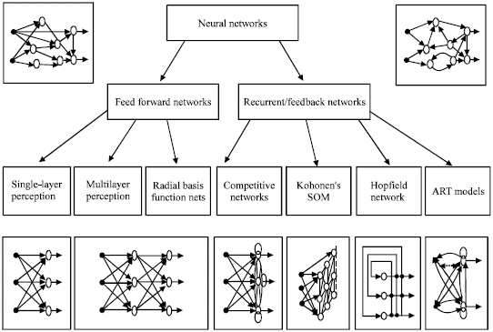

Slide 42
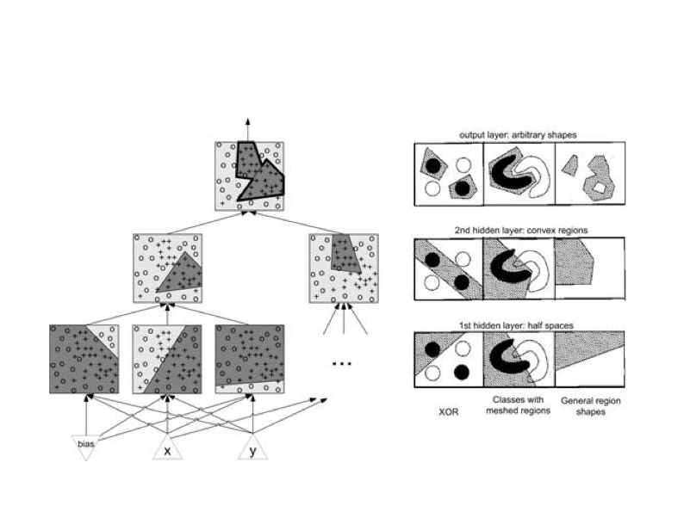

Slide 43
Hidden layers (and the weights to and from them) are the knowledge in the neural network

Slide 44
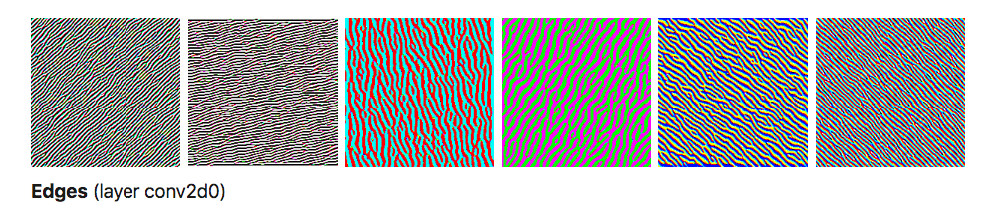
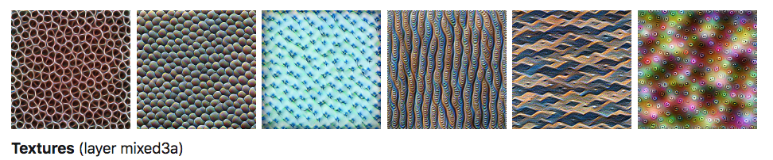
Hidden layers (and the weights to and from them) are the knowledge in the neural network

Slide 45
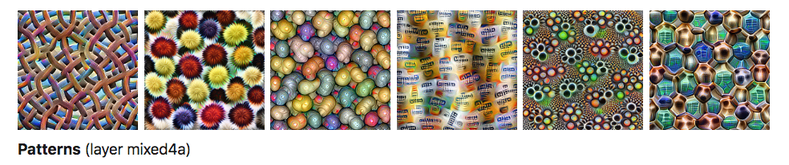
Hidden layers (and the weights to and from them) are the knowledge in the neural network

Slide 46
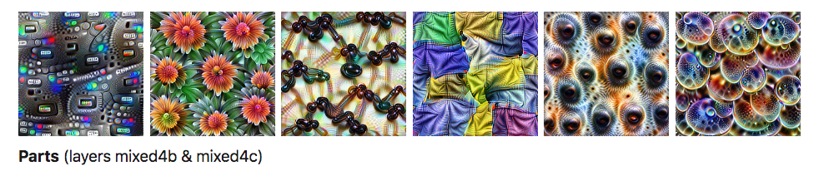
Hidden layers (and the weights to and from them) are the knowledge in the neural network

Slide 47
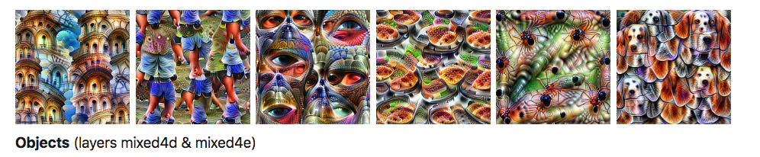
Hidden layers (and the weights to and from them) are the knowledge in the neural network

Slide 49
Features of ANNs
Input-output mapping (nonparametric statistical inference)
Nonlinearity (of processing units)
Adaptivity (parameter tuning)
Graded response (degree of 'confidence’)
Contextual information (with recurrent connectivity)
Fault tolerance (graceful degradation)
VLSI implementability
Neurobiological analogy
Uniformity of analysis and design

Slide 50
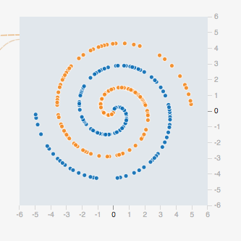
Shortcomings of Simple ANNs
Current learning algorithms are pretty slow
Merely pattern matching, not true intelligence or reasoning
Cant learn something ”outside their training set”

